Slide 1
Introduction to Git Remotes
Git

Slide 2
Topics:
Define Git Remotes
Create a repository in GitHub
Clone a GitHub repository
This creates the remote “origin”
Git Fetch and Merge = download
Git Push = upload
Remote-Tracking Branches
GitHub Forks
Add and remove remote repositories

Slide 3
STEPS TO FOLLOW

Slide 4
Initialize Git Repository
git init

Slide 5
Check Status
git status

Slide 6
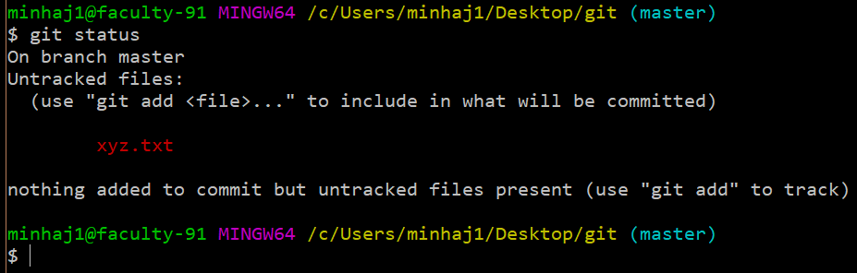
Adding File To Git Index (Staging)
If your created file is in red Color It Means you have not added your file to Git Index then Follow These Steps :
git add filename

Slide 7
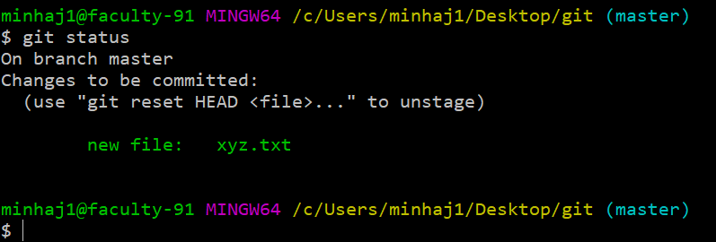
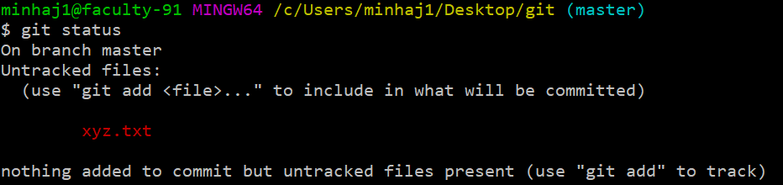
Removing File From Git Index (unstaging)
If you want to remove file from git index then you must follow these:
git reset HEAD filename

Slide 8
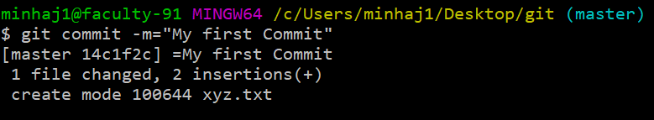
To Keep Changes
After adding file to git index, now to commit changes
Follow these steps:
git commit –m=“Your message”

Slide 9
Shortcut For Adding and Committing
If you want to add and commit in single command follow these:
git commit –a –m=“Your Message”
This will Add first and Commit your changes …

Slide 10
Configure Git UserName And UserEmail
git config --global user.name “Minhaj Afzaal”
git config –global user.email “mminhaj13@gmail.com”
To check your name and email write
git config --list

Slide 11
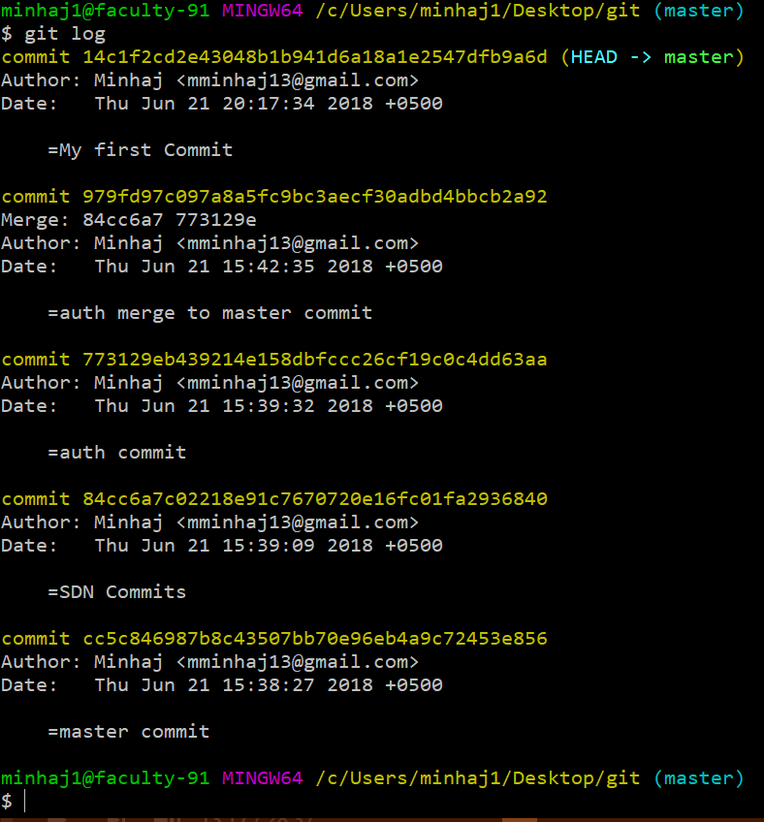
To View Commits History
git log

Slide 12
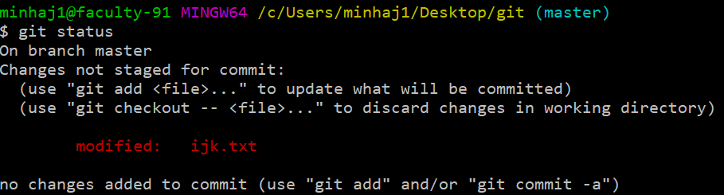
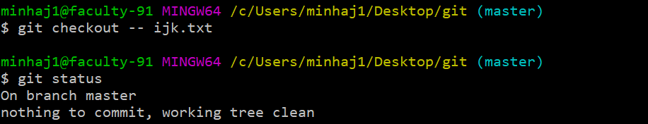
To Discard Changes
If You modified file, made some changes, and don’t want those changes to discard for below
git checkout -- filename

Slide 13
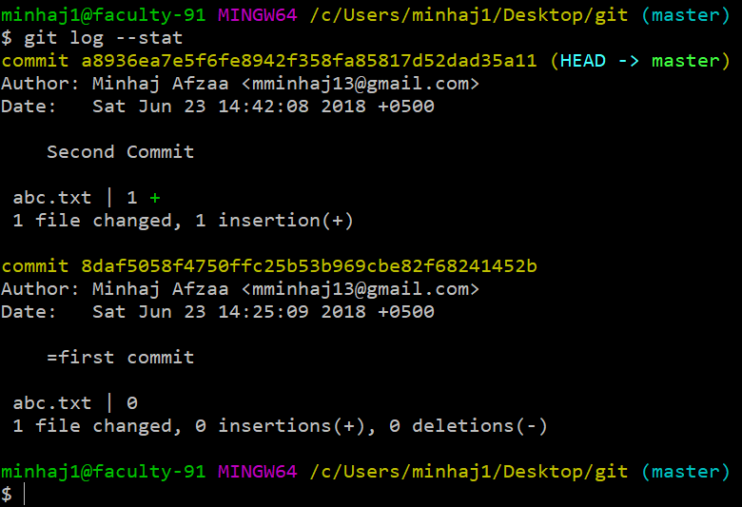
To Show Details of Commit
git log --stat

Slide 14
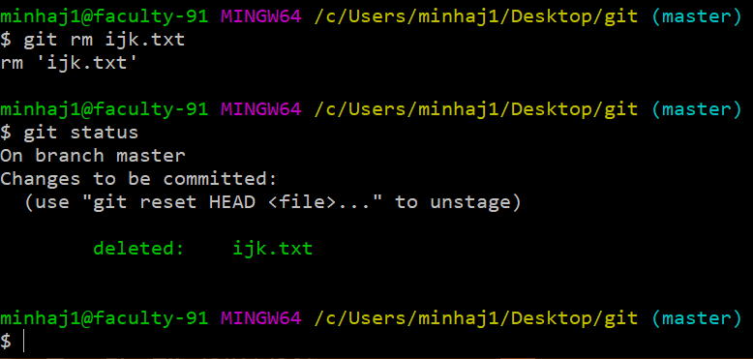
To Delete File From Directory

Slide 15
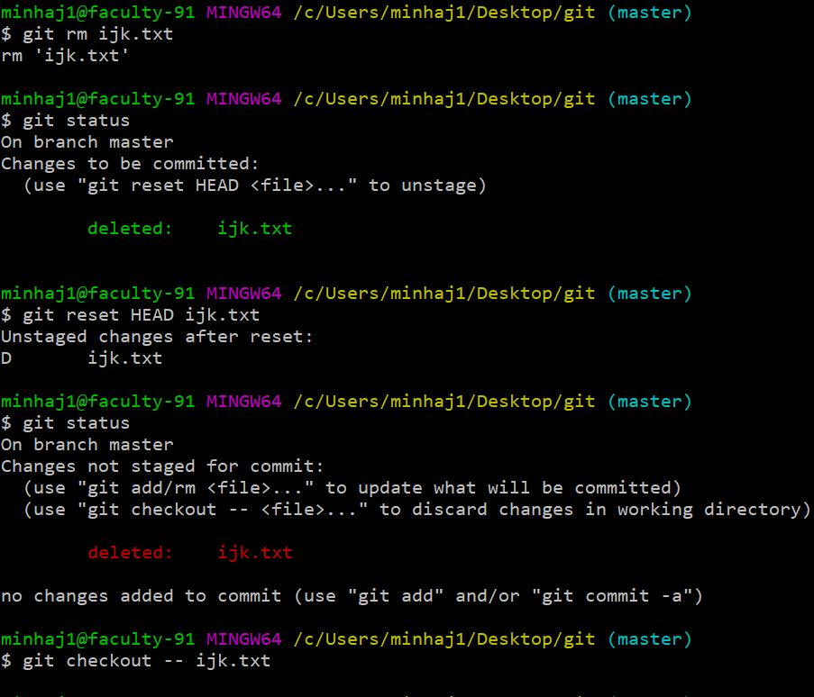
To Brink Back Deleted File

